Slide 1
Harvest DATA Via Twitter API
ZHU RUI
COMM7410

Slide 2
AGENDA – The “OSE(M)N pipeline”
Step 0 Define the Problem and the target data
Step 3 Exploring / visualizing data
Step 1 Obtaining our data
Exploratory data analysis & Find patterns and trends
What do we want to know & What data can solve our problem
Step 2 Scrubbing / Cleaning our data
Step 4 Interpreting our data
Examine the data, understand every feature of our data & Clean the data
Tell the story – solve the problem

Slide 3
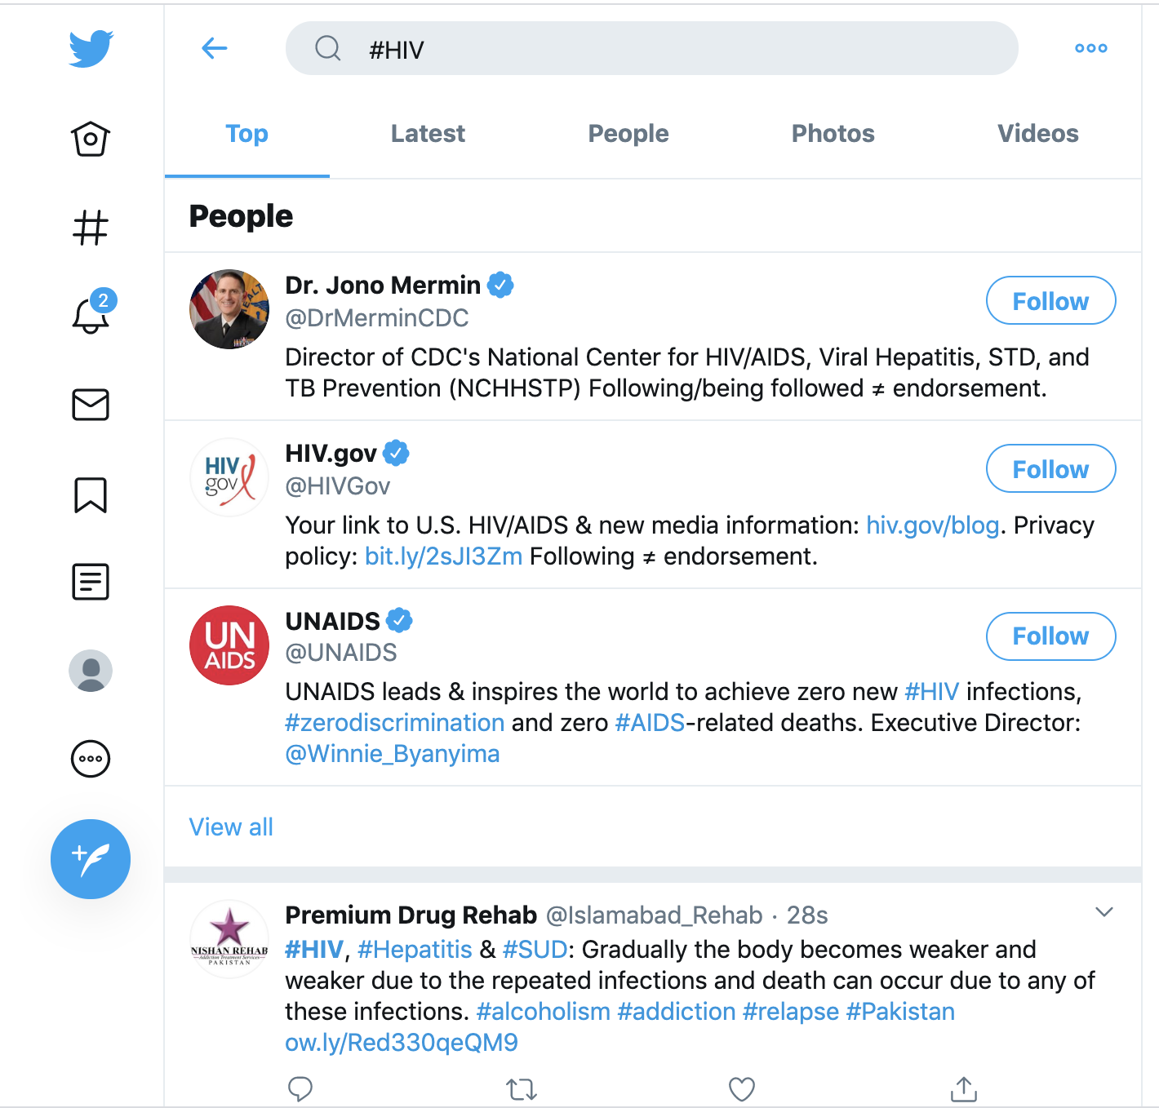




Step 0 - Define the Problem and the target data
The Problem:
how ‘HIV’ is discussed in Twitter
Trend
High frequency words
Active users
Popular tweets
…….
Target Data:
Tweets containing ‘#HIV’
#hashtag: a keyword, an index,
a navigation

Slide 4

Step 1 - Obtaining our data
Method 1: By searching
- Search data directly in the APP or website
- Manually collect ( copy & paste)

Slide 5
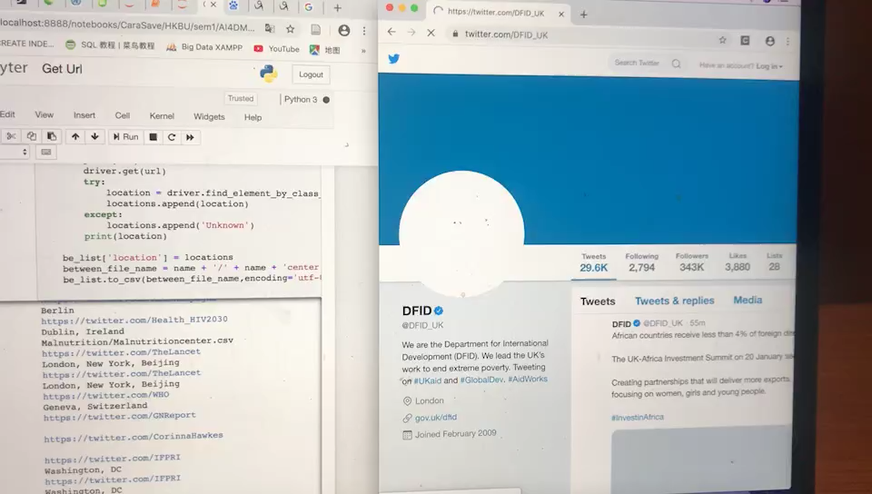
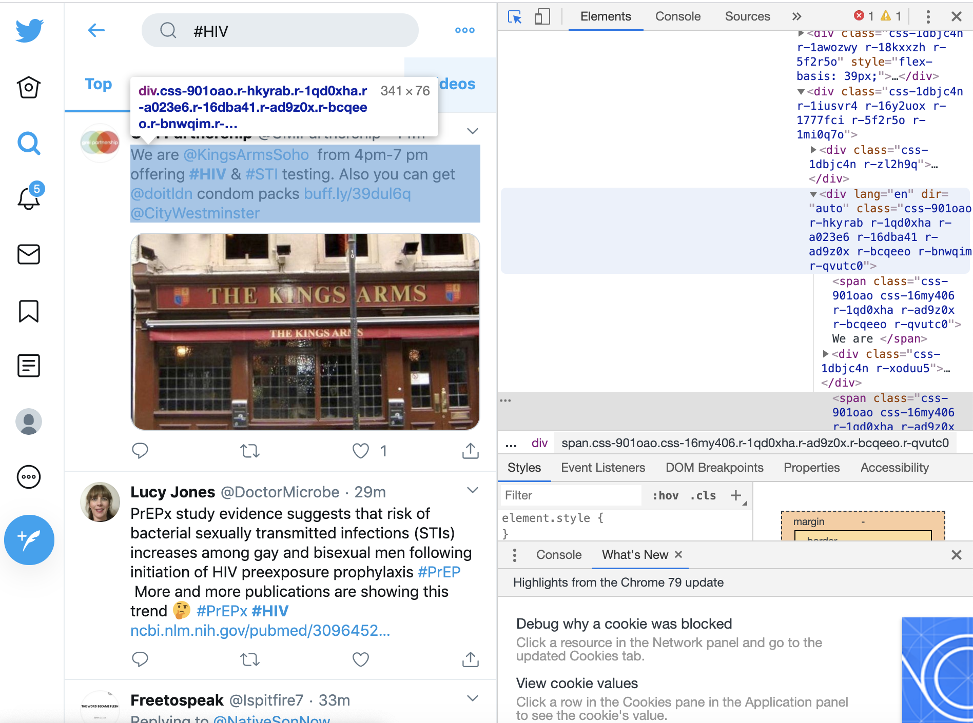
Step 1 - Obtaining our data
Method 2 : By web scraping
- Extract data from websites

Slide 6
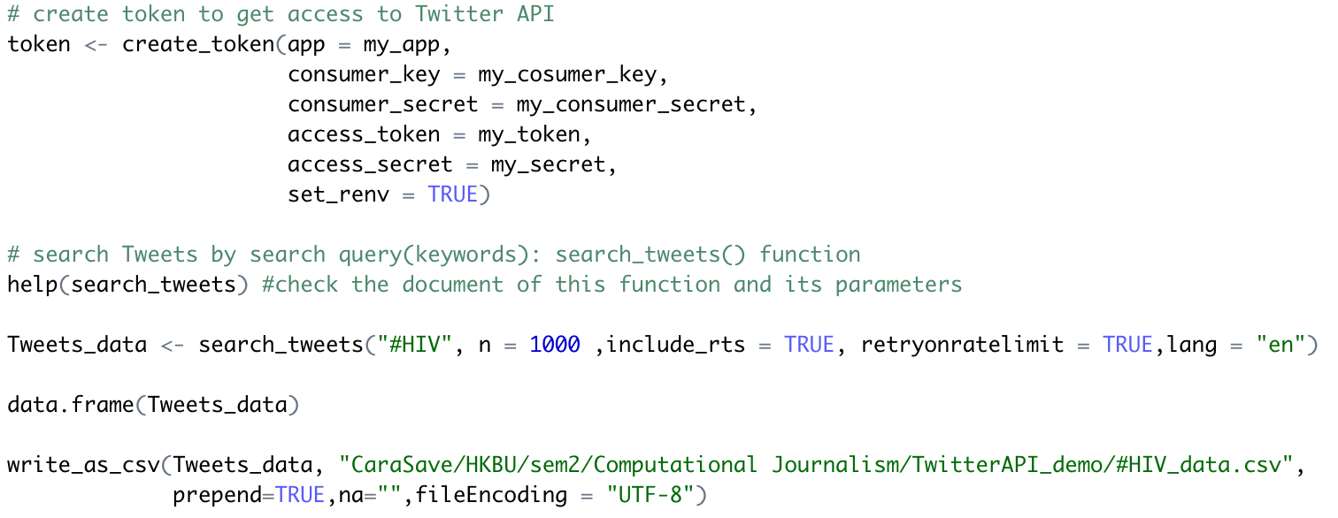
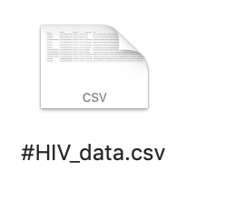
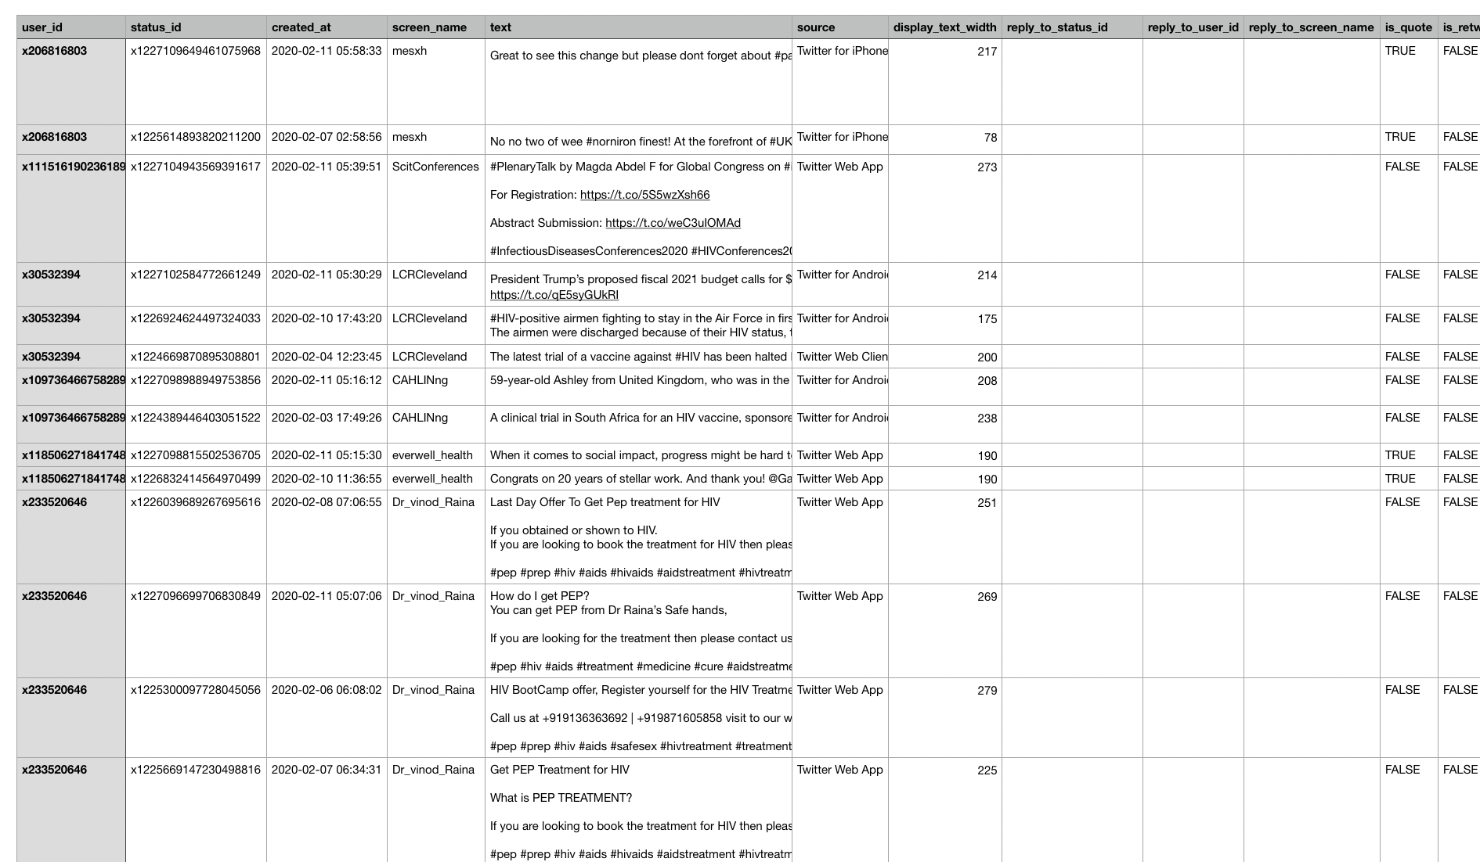
Step 1 - Obtaining our data :
Method 3: By Twitter API
An API specifies an interface and controls the behavior of the objects specified in that interface. An API is typically defined in terms of the programming language used to build an application.
• Pros:
Mutual agreement between API users and Twitter
Fast & Convenient
Structured & Machine-readable
• Cons:
Lack of flexibility & Lack of control
Platform-based & Lack of generalizability & not representative

Slide 7

Step 2 - Scrubbing / Cleaning our data
Examine the data:
understand every feature you’re working with
identify errors, missing values, and corrupt records
Clean the data:
‘Separating the wheat from the chaff’ (去芜存菁)
throw away, replace, and/or fill missing values/errors
Image by Harry Zheng

Slide 8
Step 3 - Exploring / visualizing data
How ‘HIV’ is discussed in Twitter
- Exploration 1 Trend – in R
- Exploration 2 High frequency words – in R
- Exploration 3 Active users – in R
- Exploration 4 Popular tweets – in Python

Slide 9
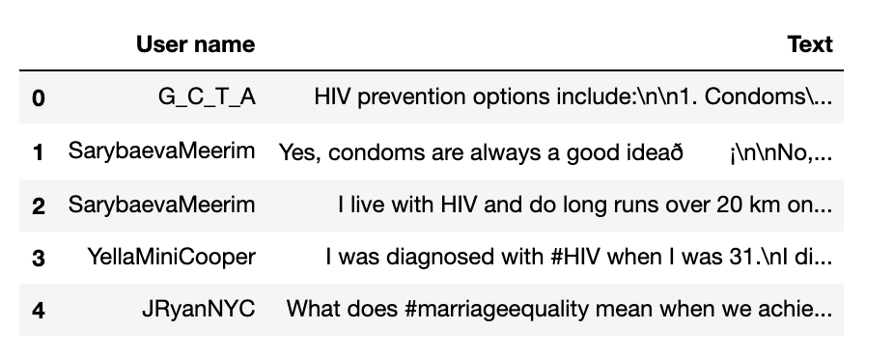
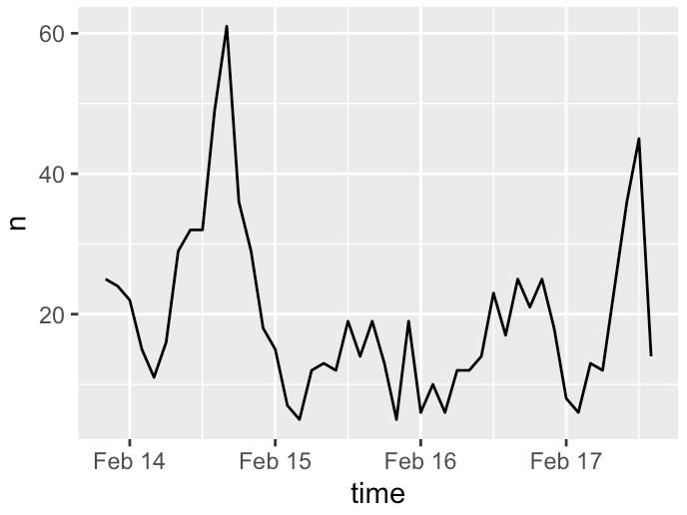

Step 4 - Interpreting our data
How ‘HIV’ is discussed in Twitter
Describe the data/plot
Answer the question/solve the problem /tell the story
Find new stories
Further investigation / further exploration

Slide 10


